Slide 1
Decision Support System for Health Insurance
Team Members:
1.Manisha Singam (11675497)
2.Lakshmi Prasanna Valdas (11700056)
3. Sekhar Reddy Kandula (11696582)
4. Abdullah Mohammed (11735589)
UNIVERSITY OF NORTH TEXAS
CSCE 5215(Section 004): Machine Learning
Professor (or Dr.): Dr. Sayed Khushal Shah

Slide 2
Abstract
The project's main goal is to assist in lowering the cost of health insurance for individuals. The answer to this issue is to use machine learning models to create a decision support system that can forecast an individual's health insurance costs and the factors that contribute to those costs. The study and findings of this effort will lower the average amount of money that Americans spend on insurance, enhance lifestyle, and assist individuals and families in making better healthcare decisions.

Slide 3
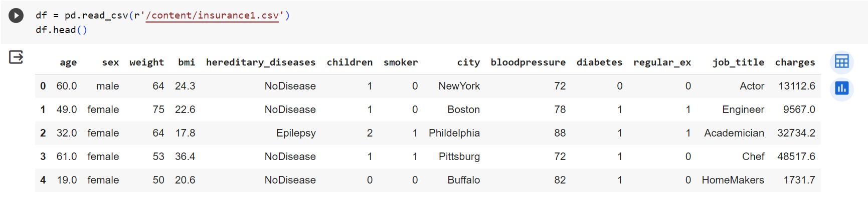
Dataset
The dataset contains 13 data features and 15000 data rows. [1] [2] Data Sources: The actual source of the dataset is from the book Machine Learning with R by Brett Lantz [3].
Input-Output pair- The input for this project is factors that contribute to health insurance costs- 13 data features and 15000 data rows. The output is the charges and features ranked by importance of contribution to insurance charges.
Importing the data-

Slide 4
Data Preprocessing
A lot of cleaning has been done on the data to make it suitable for analysis and modelling-
Check for duplicates and removing duplicates
Check for missing values and replace with mean
Convert object labels in Categorical to numerical
Detect outlier and Eliminate all outliers

Slide 5
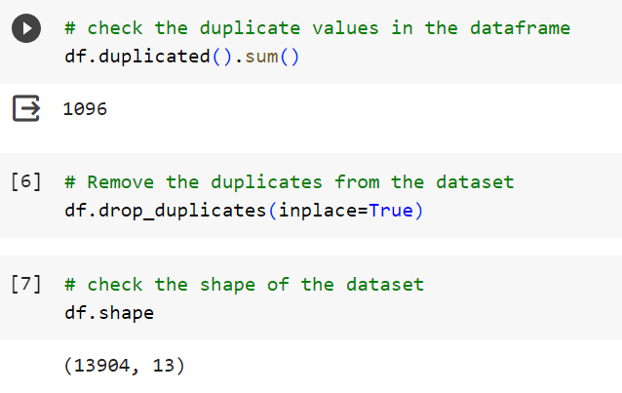
Checking duplicates and removing duplicates
Removing duplicates from the dataset-

Slide 6
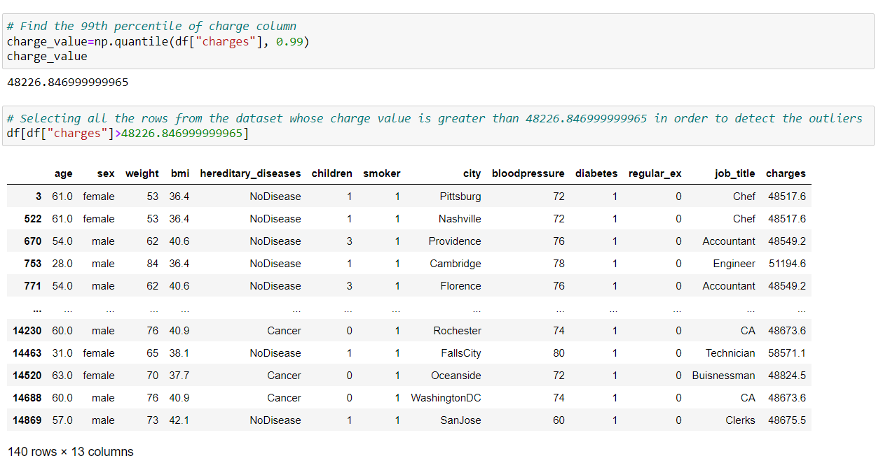
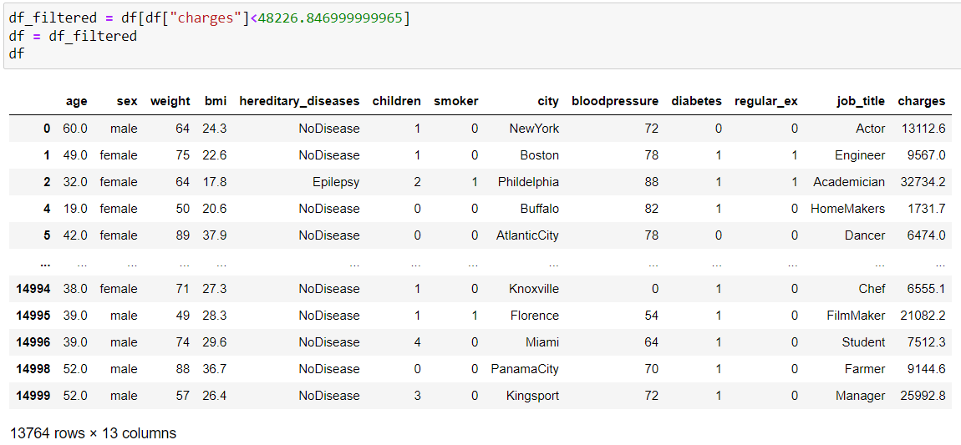
Detect outliers in the dataset-
Remove outliers in the dataset-
Removing duplicates from the dataset

Slide 7
Exploratory Data Analysis
Statistical Distribution –
mean, median, distinct, skewness, kurtosis
Categorical Data Analysis –
data quality check using null value analysis
Numerical Data Analysis –
data quality check using null value analysis
Data Distribution of various features, combination of features

Slide 8
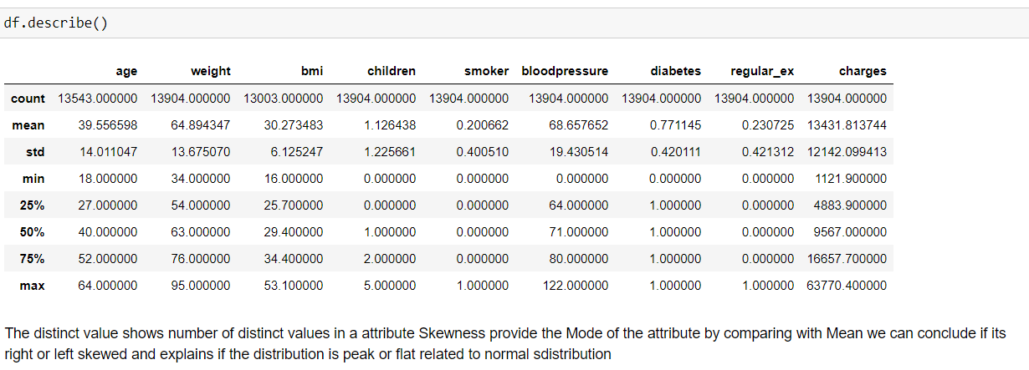
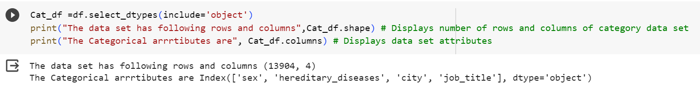
Statistical Distribution –
Categorical Data Analysis

Slide 9
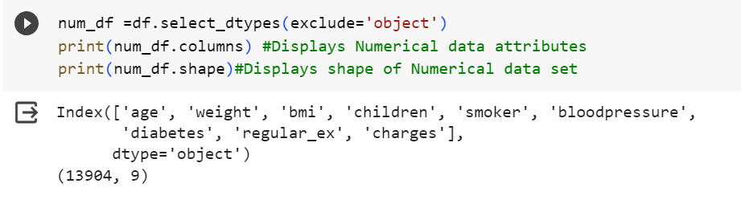
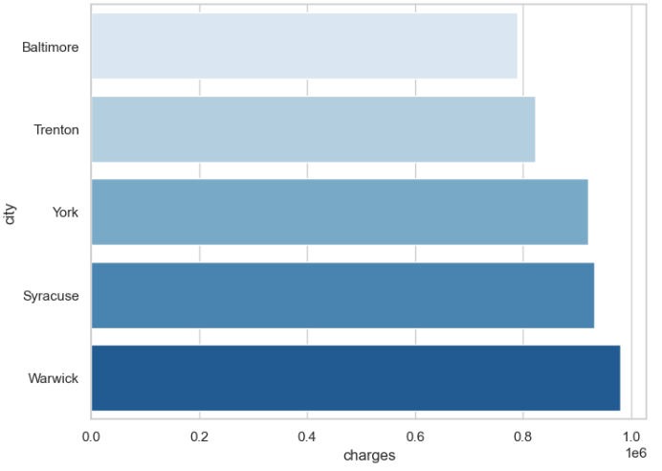
Numerical Data Analysis –
Distribution of charges by city-

Slide 10

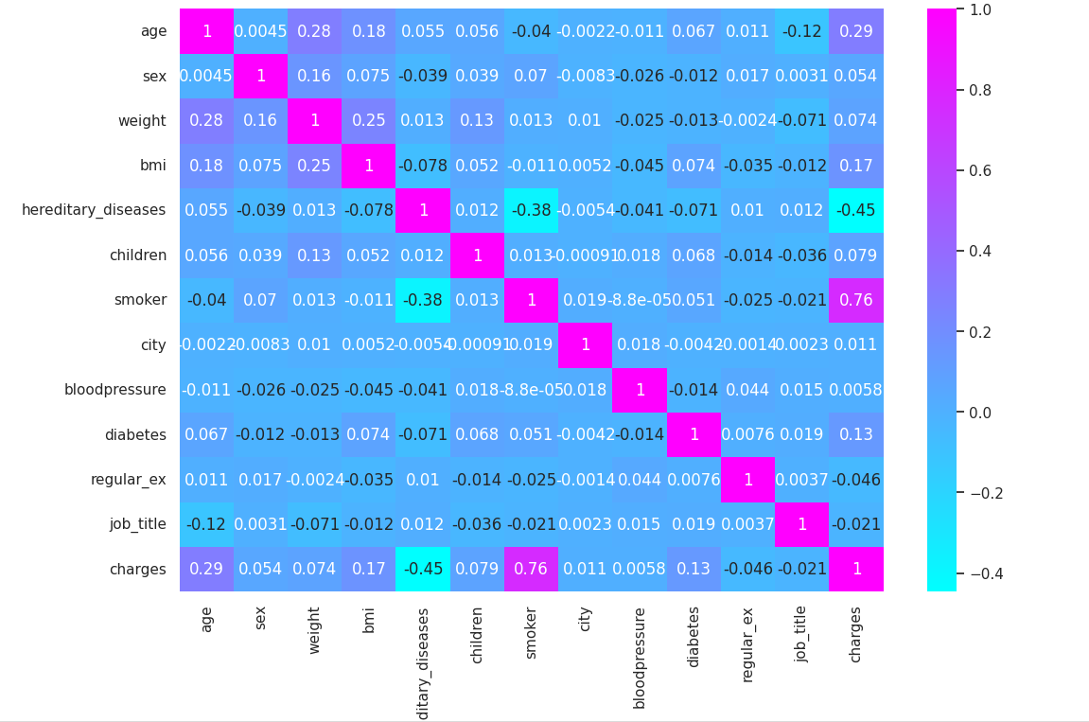
Feature Selection
Finding correlation between variables-
Correlation Matrix:

Slide 11
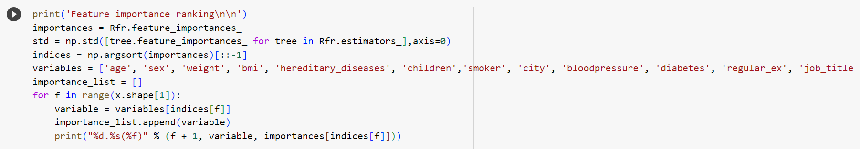
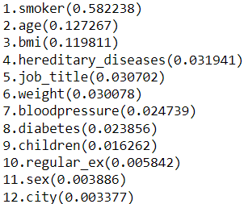
Feature importance ranking
Feature Importance Ranking-

Slide 12
Model Selection
Linear Regression, Lasso Regression, Elastic Net Regression, Kernel Ridge Regression, SVR, Random Forest Regressor, Gradient Boosting, Extreme Gradient Boosting, LGBM and combination of models (Ensemble Model) will be used for this project.
Baseline- Linear Regression is used as the baseline to compare the results against for predicting the health insurance costs.
Lasso Regression- adds the penalty equivalent to the absolute value of the sum of coefficients. Uses L1 regularization.
Elastic Net- is the combination of both Ridge and Lasso Regressions. It adds both the sum of squared coefficients and the absolute sum of the coefficients with the ordinary least square function. It is useful when there are multiple features that are correlated.
Kernel Ridge Regression- is a non-parametric form of ridge regression. The aim is to learn a function in the space induced by the respective kernel k by minimizing a squared loss with a squared norm regularization term.
Gradient Boosting- is generally used when we want to decrease the bias error. In each stage, a regression tree is fit on the negative gradient of given loss function.
Extreme Gradient Boosting- is a scalable tree boosting algorithm. It is designed to be boyh computationally efficient and highly effective.
Light Gradient Boosting Machine- is based on decision tree algorithms and used for ranking, classification, and other machine learning tasks.

Slide 13
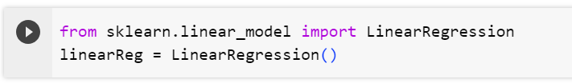
Baseline for Linear Regression:
Linear Regression is used as the baseline to compare the results against for predicting the health insurance costs.

Slide 14
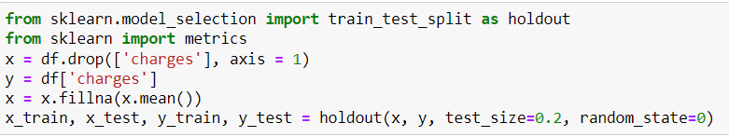

Model Training and Hyperparameter Tuning
Train models using k-fold cross-validation. Regularize the model’s ability to structurally prevent overfitting by imposing a penalty on the coefficients. The models with optimal hyperparameter tuning will be evaluated by comparing the predictions of each model with validation data.
Training models using k-fold cross-validation and seeing the performance of all the models in the given dataset.

Slide 15
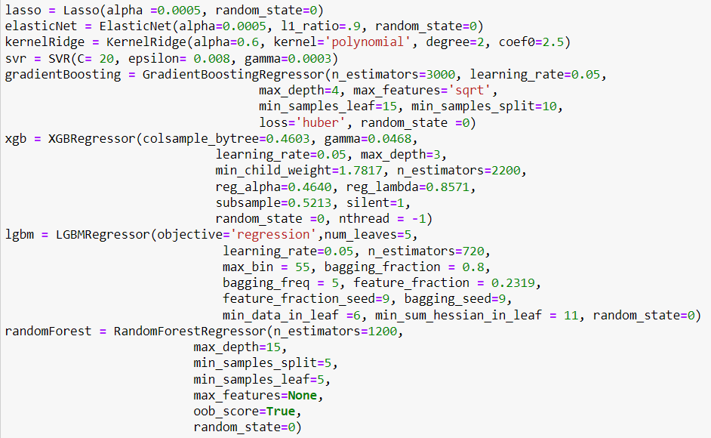

Slide 16
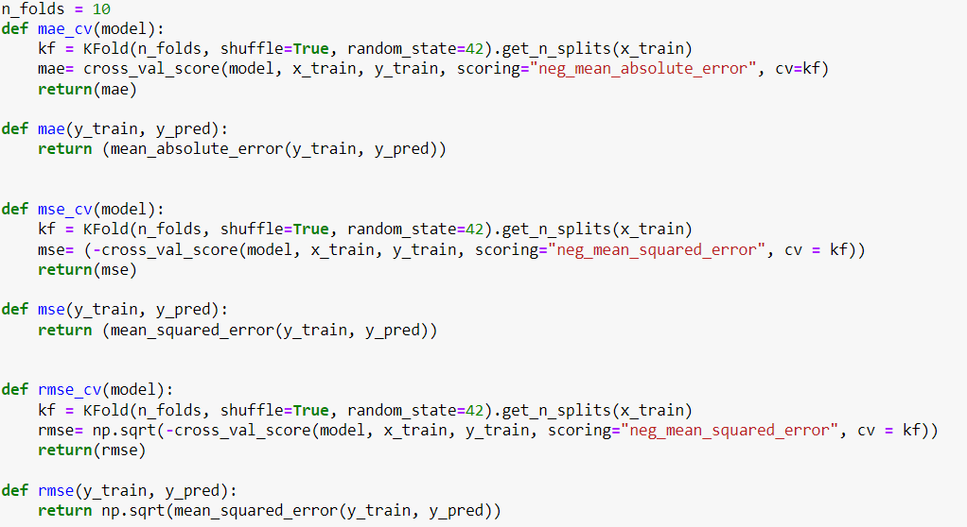
Model Evaluation
The models will be evaluated using Mean Absolute Error, Mean Squared Error, Root-Mean-Square-Error score metrics which describe the differences between the predicted values and the observed values.
Evaluation Metric- The performance will be evaluated using Mean Absolute Error, Mean Squared Error, Root-Mean-Square-Error metrics against the baseline. Lower the score, better the model.
Mean Absolute Error, Mean Square Error and Root Mean Square Error can range from 0 to infinity. The lower the score, the better the prediction.

Slide 17
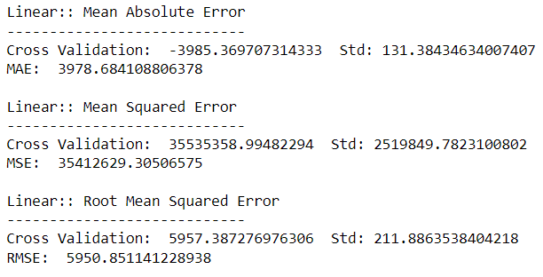
The results for evaluation metrics for the baseline model are-

Slide 18
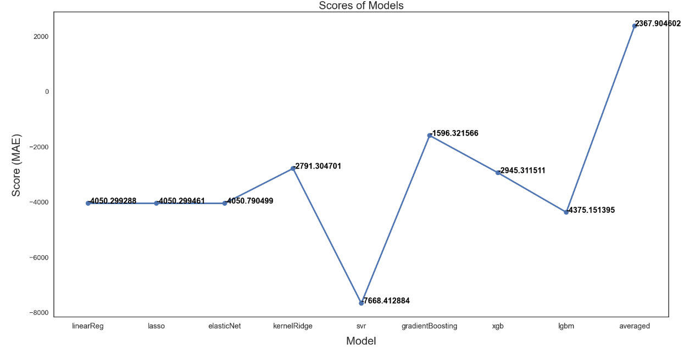
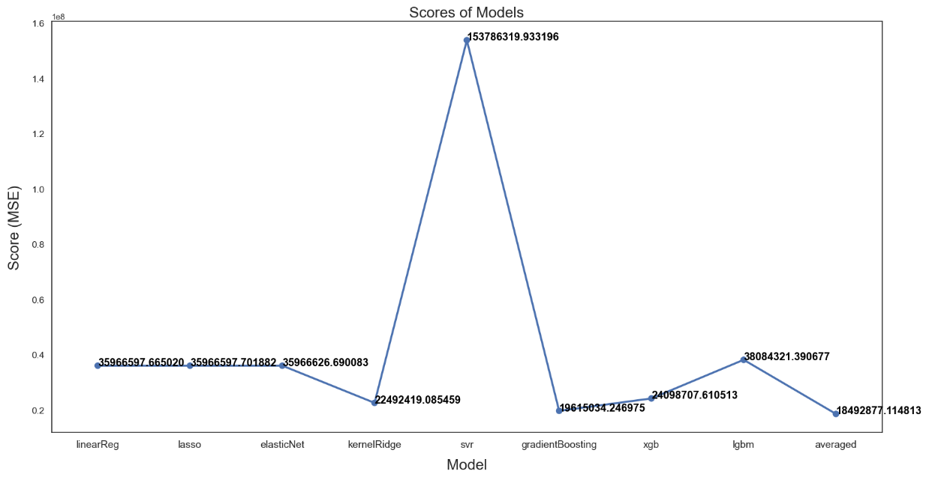
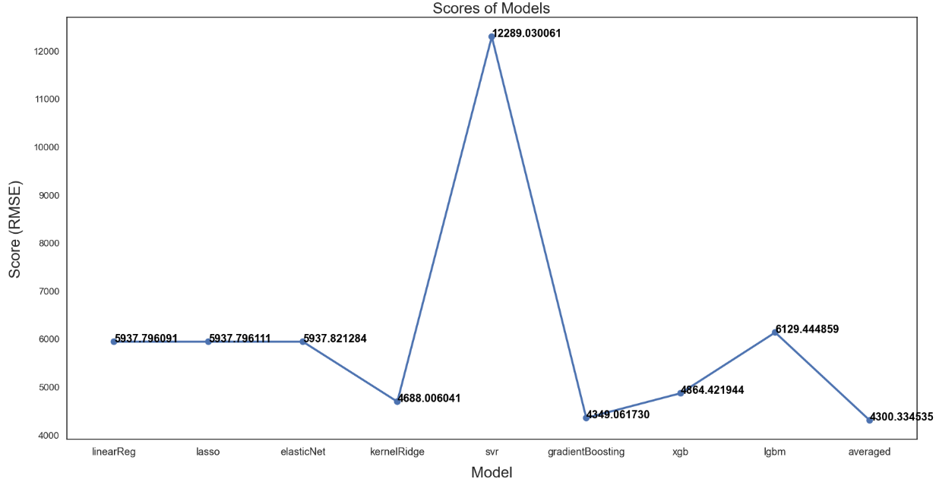

Slide 19
Conclusion
A decision support system can assist a person in making better selections by identifying the aspect that most influences insurance prices. Python has been used to create the decision support system for calculating insurance costs and identifying the characteristic that contributes the most to insurance expenses. The results from the decision support system show that Smoking is the most contributing feature for insurance costs.

Slide 20
References
Lantz, B. (2019). Machine learning with R: expert techniques for predictive modeling. Packt publishing ltd.
Roger, Z., Pavlov & Nacho, C. (2017, March 28). Machine-Learning-with-R-datasets. GitHub. https://github.com/stedy/Machine-Learning-with-R-datasets

